Slide 1
Machine Learning for Fashion Analysis
Practical application of fashion recognition using Deep Neural Networks

Slide 2
Fashion Analysis
“Half the money I spend on advertising is wasted; the trouble is I don't know which half.” - John Wanamaker, 1922
Problem In fashion retail
→ What are customers interested in?
→ How can I convince the customer to buy my products?
Machine Leaning Solution:
Let’s build a fashion image analyzer, to analyze existing fashions and better reach the customer through targeted advertising
Challenges:
→ What is important in the image?
→ What should the ML model recognize?
→ How can the ML model distinguish between a “Shirt” and a “Blouse”?
Conclusion: A ML model needs to understand the key characteristics to analyze

Slide 3
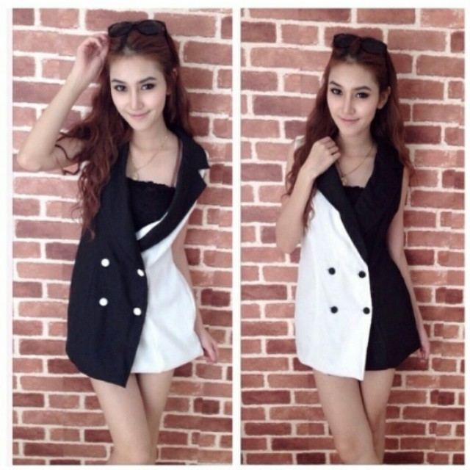
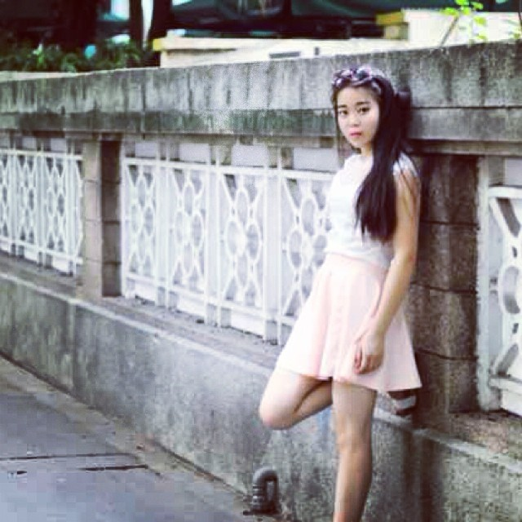
Fashion Analysis
1: “Breakfast at Tiffany’s”: http://youtube.com
2: “StreetStyle”: http://streetstyle.cs.cornell.edu/
3: “online fashion images”: http://de.zalando.ch
Example usage:
Match current pattern, recommend possible interesting items for customer from store
Customer approaches store
“My Boutique”
Classic Retail
ML models detect the current clothing items from image
*1
Bounding box location
Recommender Engine
DL
*3
Category: ‘full’
ML Image Detector model
DL
Customer uploads
Online Retail
ML Image Classifier model
*2
Class: ‘dress’
Use Case: Evaluation of image for fashion recommendation

Slide 4
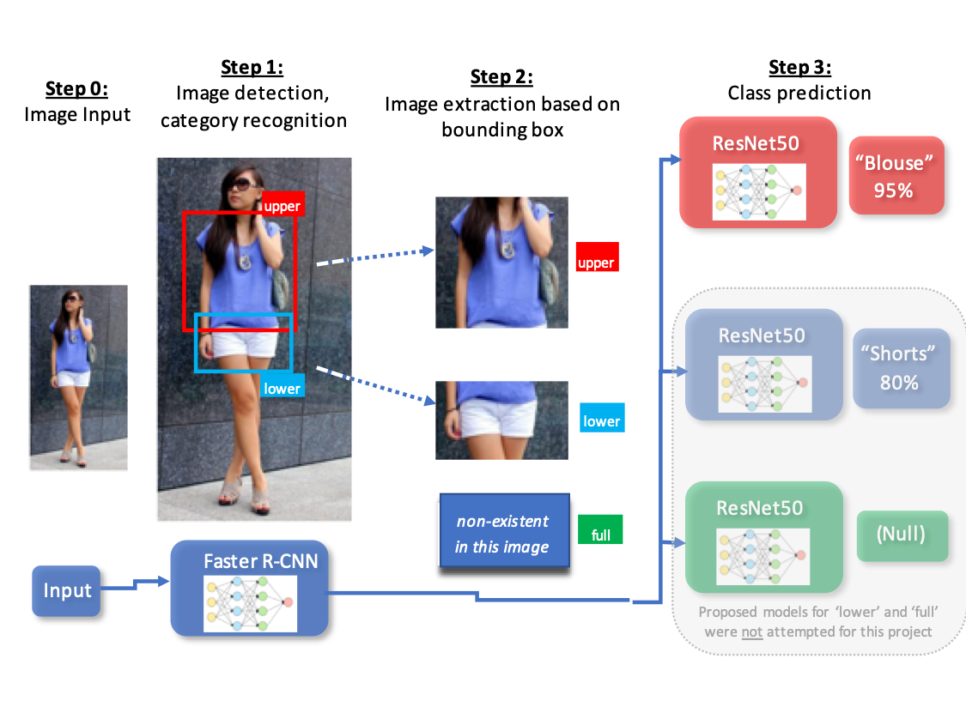
Fashion Analysis Models
*1
1: “StreetStyle”: http://streetstyle.cs.cornell.edu/
Solution: Separate detection and classification tasks into separate models
By reducing complexity into separate tasks, a better result can be achieved
A multi-model approach was selected for analysis:
Image Detector: “Faster R-CNN” based model
Image Classifier: “ResNet50” based models

Slide 5
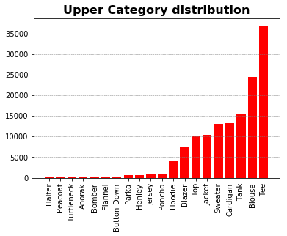
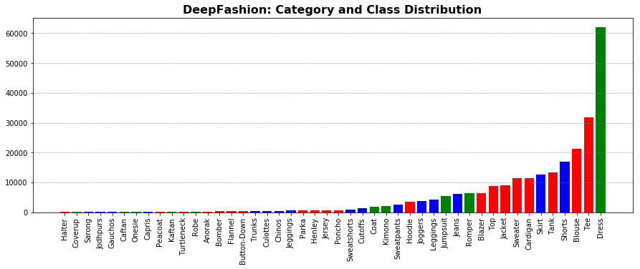
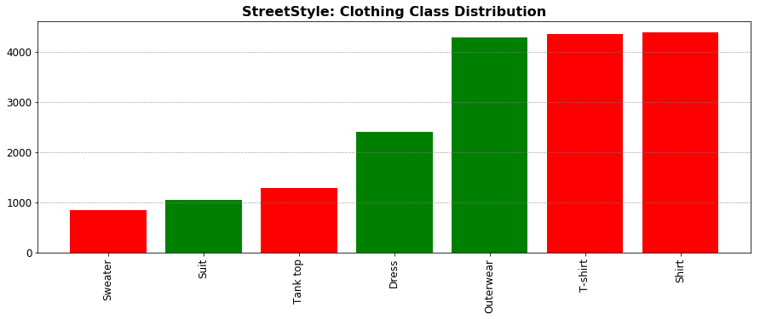
Fashion Datasets
1: “DeepFashion”: http://mmlab.ie.cuhk.edu.hk/projects/DeepFashion.html
2: “StreetStyle”: http://streetstyle.cs.cornell.edu/
DeepFashion:
training dataset of fashion items
StreetStyle:
test dataset for fashion “in the wild”
DeepFashion¹
StreetStyle²
Only 9 classes were selected from ‘upper’ for classifier model training
289k fashion images,
46 classes with bounding box annotations
Mostly curated fashion images
27k face & torso images
5 classes with bounding box annotation
Fashion images “in-the-wild”
Categories:
upper .
lower .
full .
Categories:
upper .
lower (N/A)
full .
Training the models used only curated images
Testing models sets used both curated and “in-the-wild” type images

Slide 6
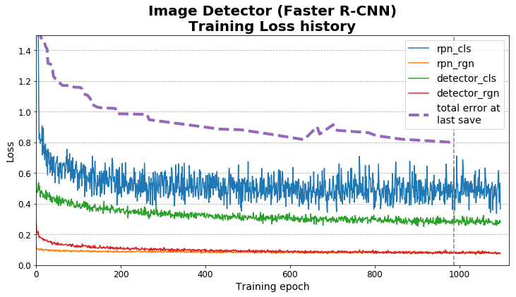
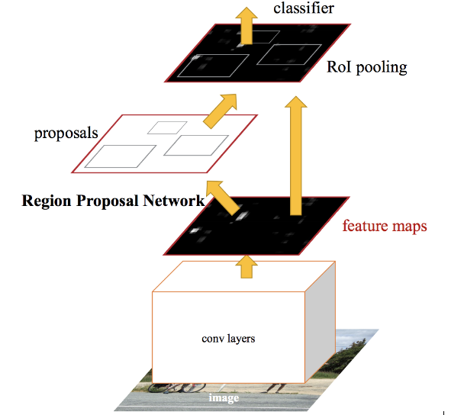
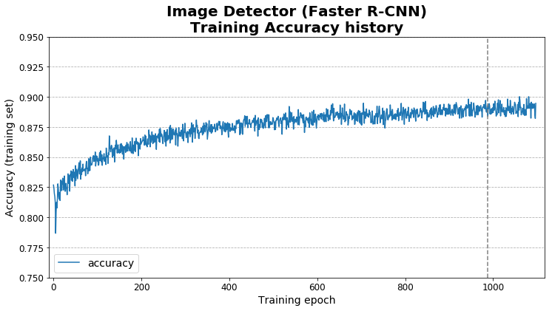
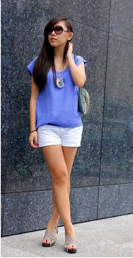
Image Detector: Faster R-CNN
1: “Faster R-CNN”: https://arxiv.org/abs/1512.03385
Image Detector model:
“Faster R-CNN” architecture
Categories:
‘upper’
‘lower’
‘full’
Bounding box:
(x₁,y₁,x₂,y₂)
Training on DeepFashion dataset:
987 epochs x 1000 steps per epoch
32 images per batch → ~850 s/epoch
Full training was ~10 days
Image detector model was trained for 3 categories with bounding box information

Slide 7
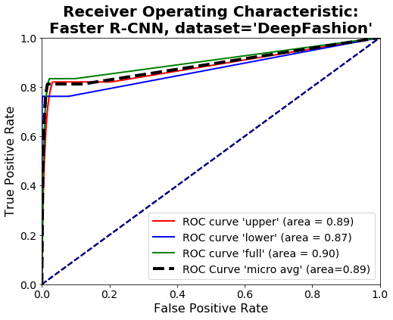
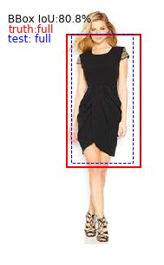
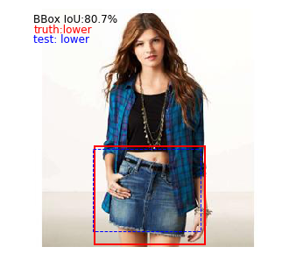
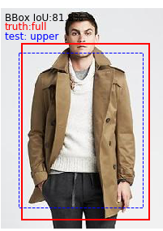
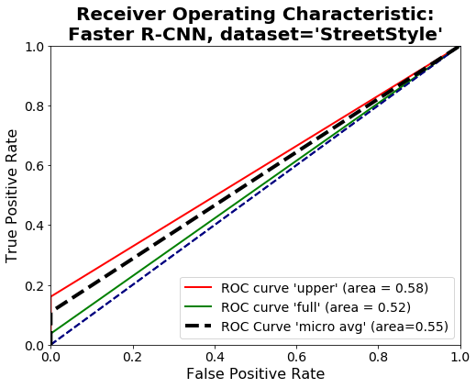
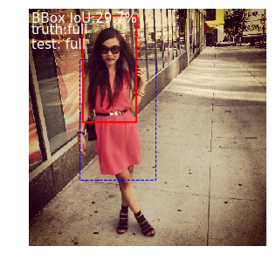
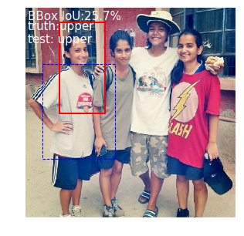
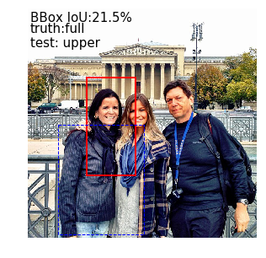
Image Detector: Faster R-CNN
Overall Results of test datasets
DeepFashion:
Success
Success
Failure
StreetStyle:
Success
Success
Failure

Slide 8
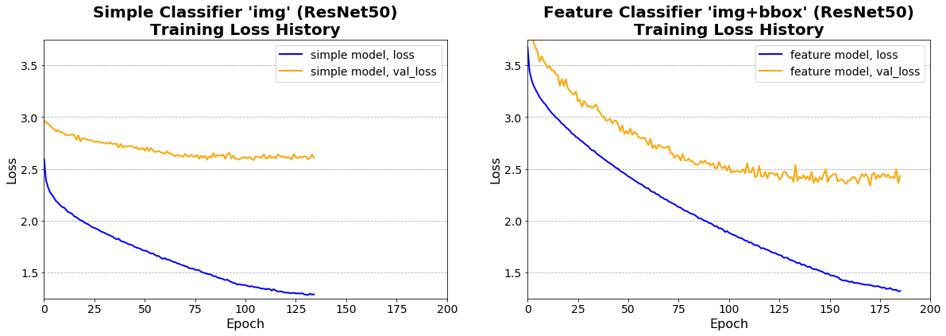
Image Detector: ResNet50
9 classes selected with > 2000 images
Image Classifier models:
“ResNet50” architecture with and without bounding box entrainment
Image Classifier ‘img’ and ‘img+bbox’ models were both attempted to determine the influence of feature inclusion in model training

Slide 9
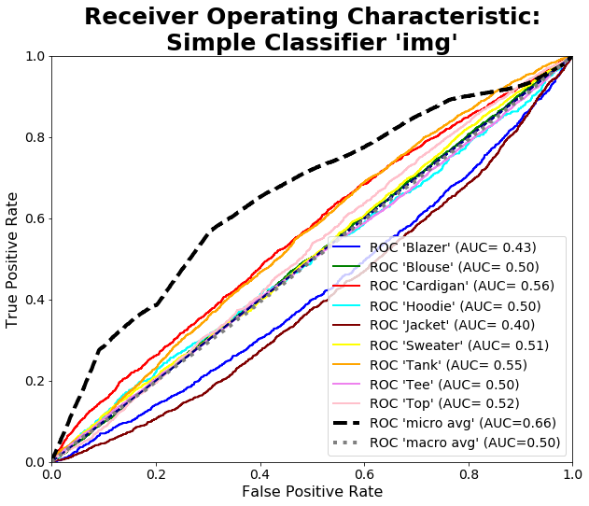
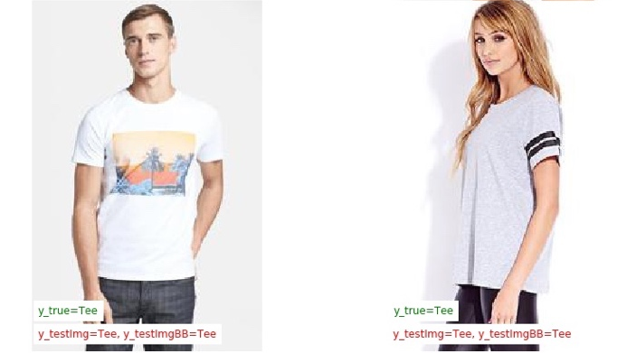
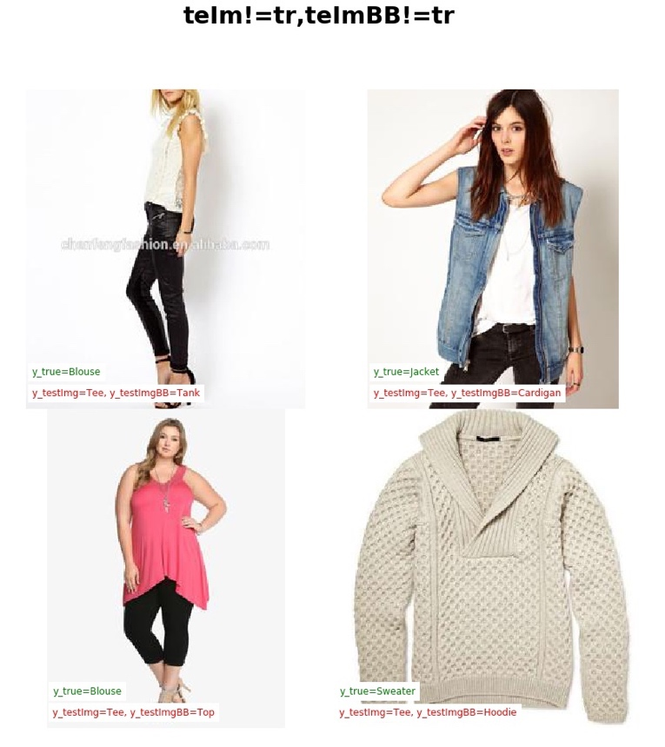
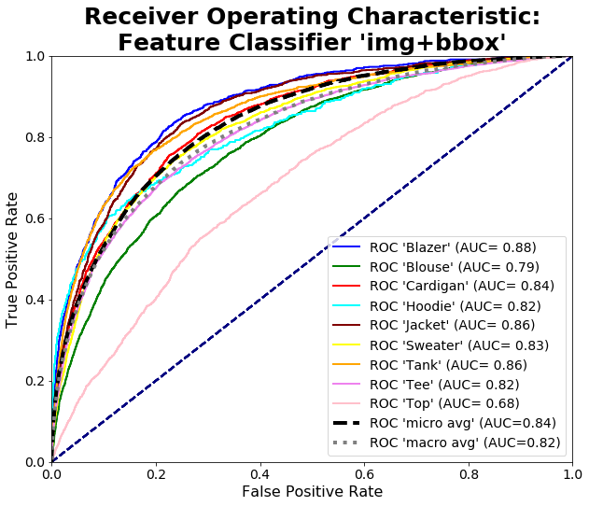
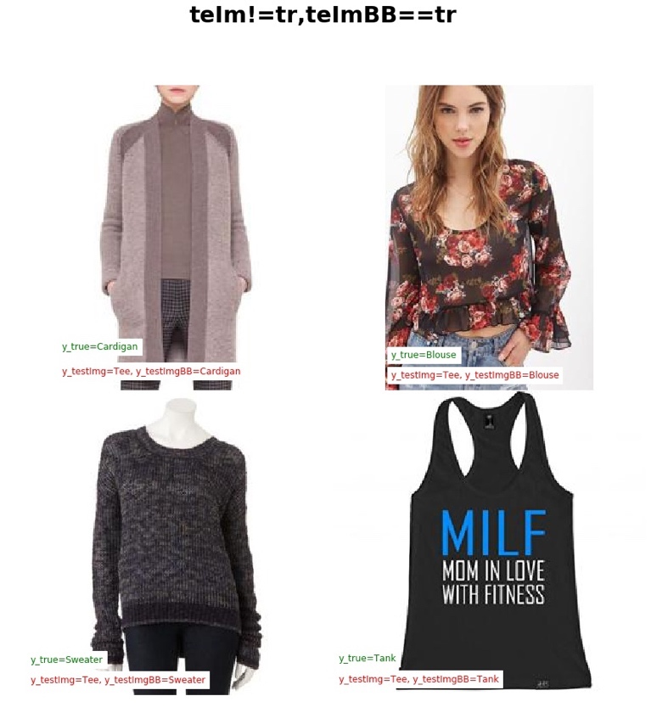
Image Classifier: ResNet50
Overall Results of test datasets
Simple Classifier ‘img’
Success
Success
Failure
Feature Classifier ‘img+bbox’
Success
Success
Failure

Slide 10
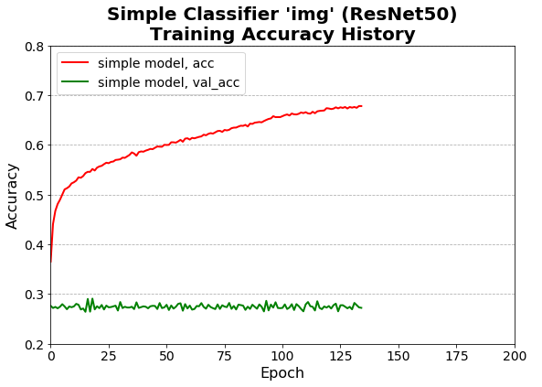
Image Detector: ResNet50
What went wrong with the Simple Classifier (‘img’) ?
Simple classifier
Approximately 27% accuracy
which is equal to N_{tee} /N_{total}
…the Simple Classifier minimized its error by choosing the majority class for every prediction. The resulting model is useless for prediction…
By better feature engineering, more attributes can be linked with the image aspects and thus lead to better model predictions

Slide 11
Conclusions
What is important for fashion image analysis?
…Datasets:
A well-balanced class distribution is as important as number of samples
A model trained on curated images will learn to predict only curated images…a better model will be trained on images as you wish to detect them (“in-the-wild”)
However, make sure there is something to learn from the images (“annotations”)
…Models:
In general, a model which addresses more features (‘breadth’) will outperform a complicated model (‘depth’) which does not address the features of the image.
Be sure to check the end results, to make sure your model didn’t take a ‘lazy’ approach (i.e. guess the majority class)

Slide 12
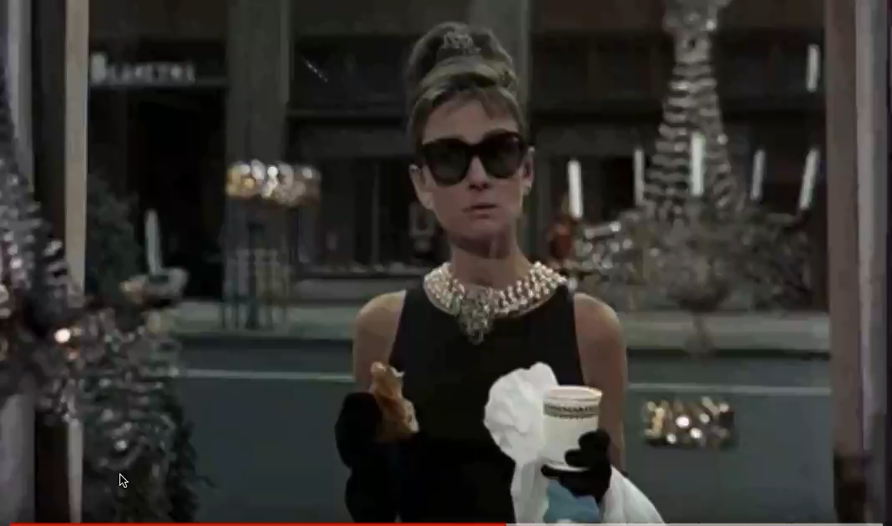
Questions?
Original clip: “Breakfast at Tiffany’s”
© 1961, Paramount Pictures

